Slide 1
Credit Card Fraud Detection
Rania Anwar
Supervisor Name: Tamer Abdou, PhD
Submission Date: July 24, 2023

Slide 2


Table of Contents
01
02
03
04
Understanding Credit Card Fraud
Define credit card fraud (CCF), briefly visualize credit card transactions data,
analyze existing literature on the topic
Objective and Research Questions
Outline the objectives of the project followed by proposing the research questions that will be investigated
Methodology
Discuss the approach taken to answer research questions along with the tools necessary
Results
Elaborate on the key findings, compare results from the literature, highlight limitations and recommendations
Source: Sakasegawa (2022)
Notes:
Image Source
Sakasegawa, J. (2022, December 9). Emerging Fraud Trends to Look for This Holiday Season. PaymentsJournal. https://www.paymentsjournal.com/emerging-fraud-trends-to-look-for-this-holiday-season/

Slide 3
01
Understanding Credit Card Fraud

Slide 4
What is Credit Card Fraud (CCF)
Credit card fraud occurs when a person uses a stolen credit or information to make unauthorized purchases under the person’s credit card name (Rafter, 2017)
Several approaches for fraudsters to attain one’s credit card information
Fake websites (Rafter, 2017)
Phishing emails (Dickey, 2021)
Data breaches (Rafter, 2017)

Slide 5
The State of Credit Card Fraud
“Three-in-five 18-34 year olds (63%) report being a victim of at least one type of financial fraud in their lifetime” (Chartered Professional Accountants of Canada, 2023)
72% of participants in the study with credit cards state that they manage their finances online (Chartered Professional Accountants of Canada, 2023)
“Costs the global economy $5.127 trillion annually” (Falco, 2023)
72% of businesses globally reported an increase in fraud within 12 months

Slide 6
Data Science and Credit Card Fraud
Data science is significantly involved in collecting, summarizing, and predicting banking data to identify suspicious activities (Qualetics Team, 2019)
Models are created to classify credit card transactions based on features such as amount, location, merchant, month, etc.
Machine learning plays a critical role in fraud detection (Kosourova, 2022)
Approached through supervised or unsupervised methods
Notes:
‌

Slide 7
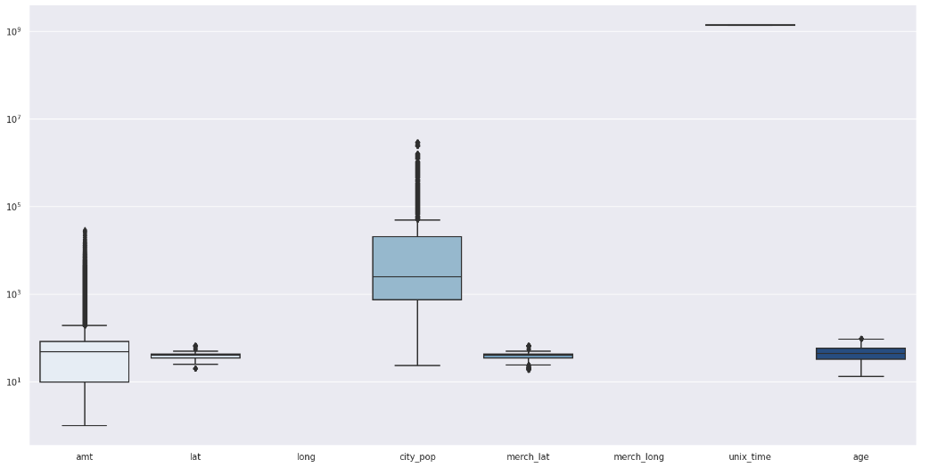
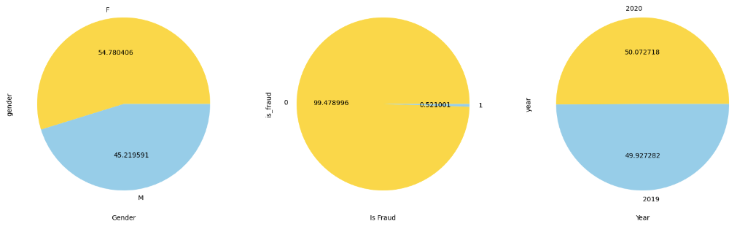
Exploring Credit Card Transaction Data

Slide 8
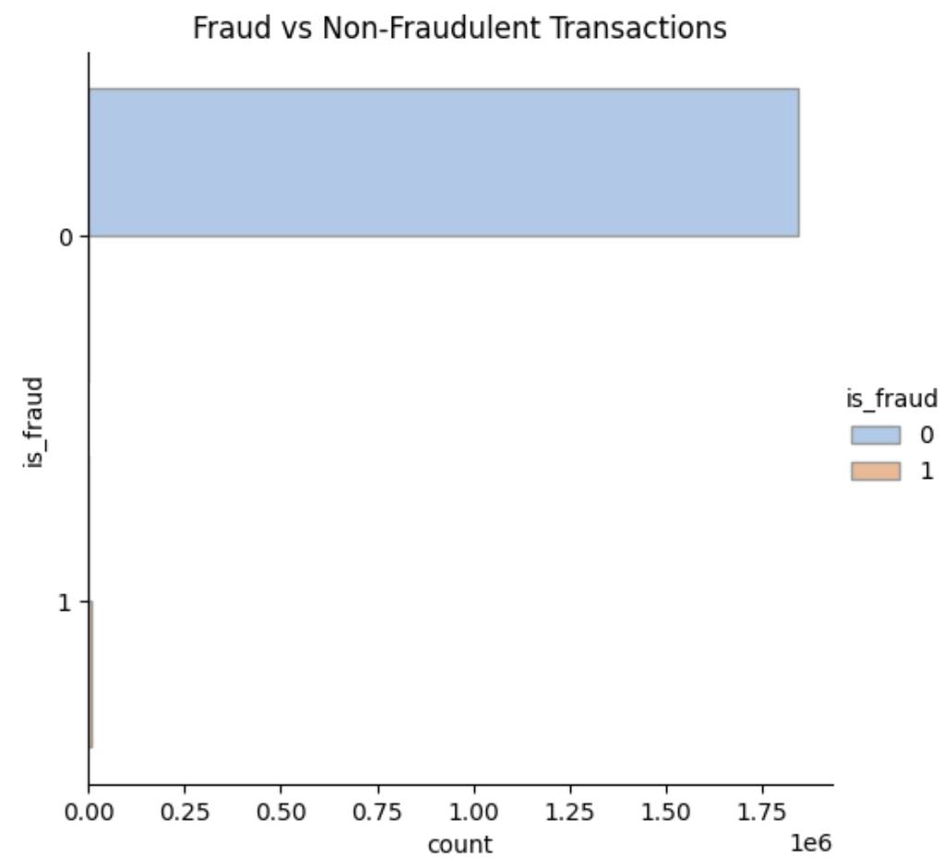
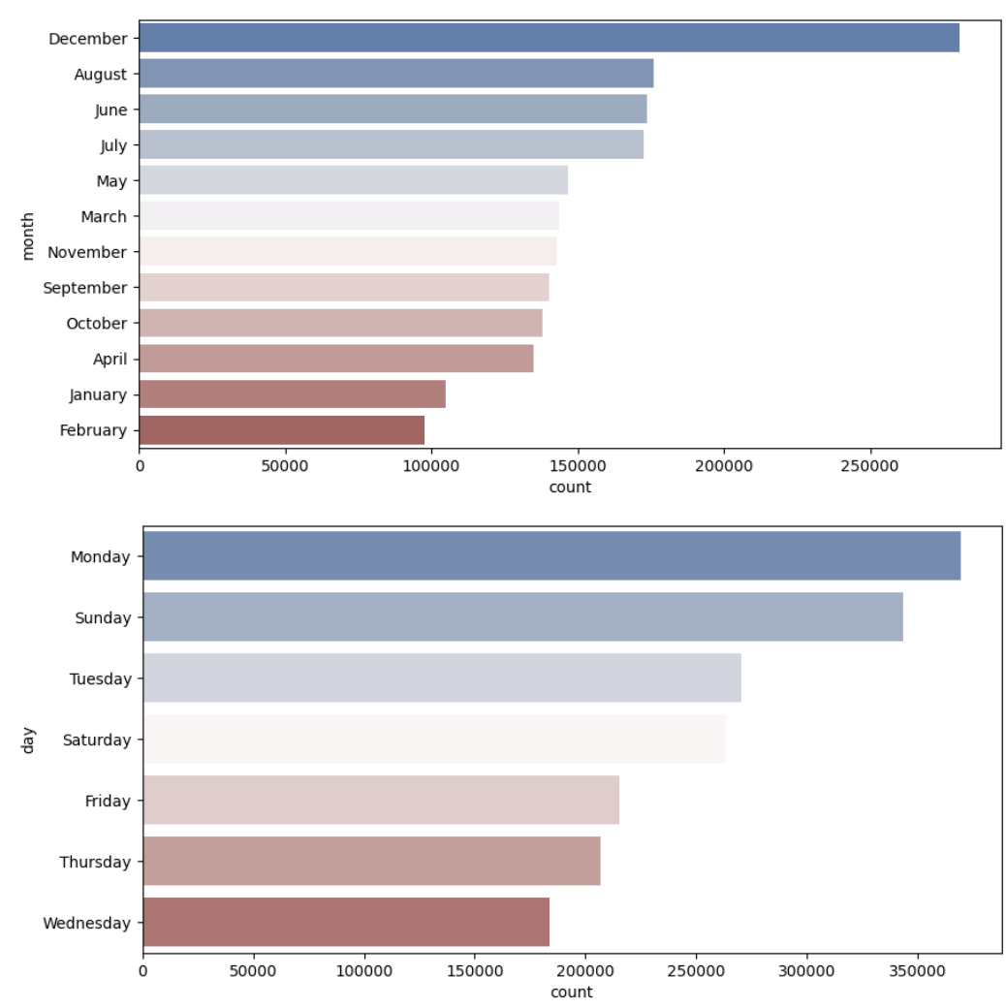
Exploring Credit Card Transaction Data

Slide 9
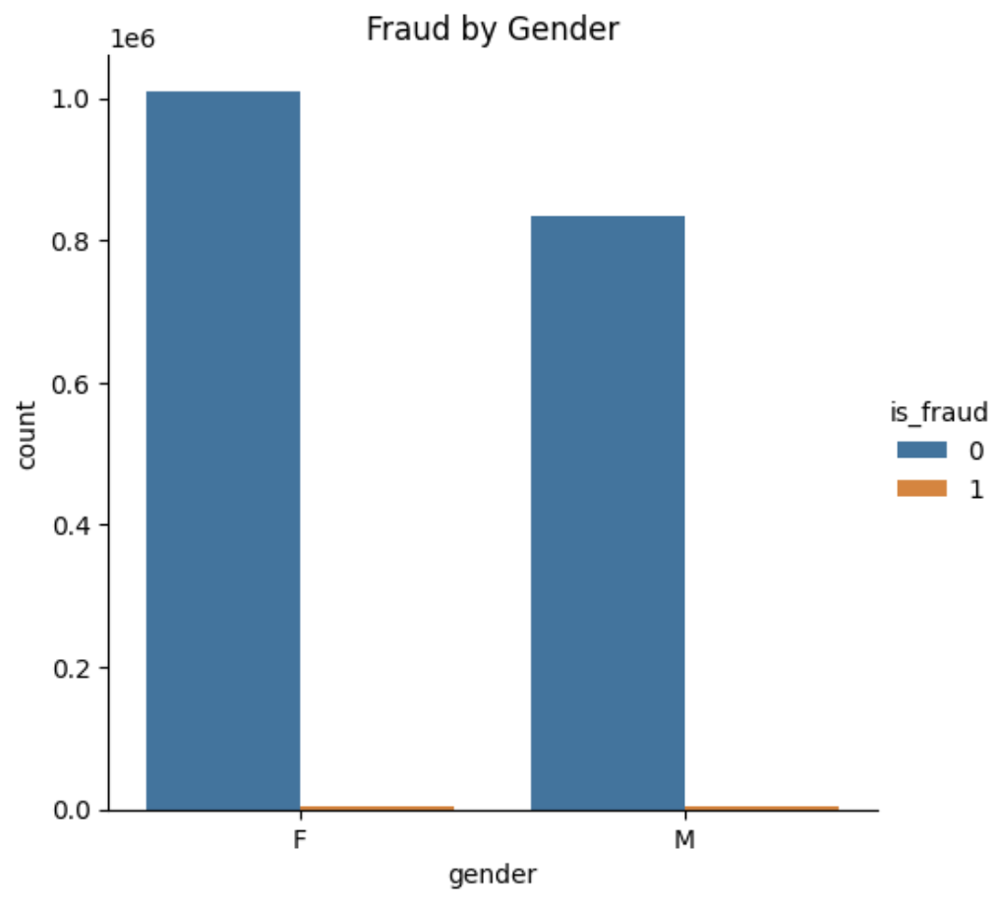
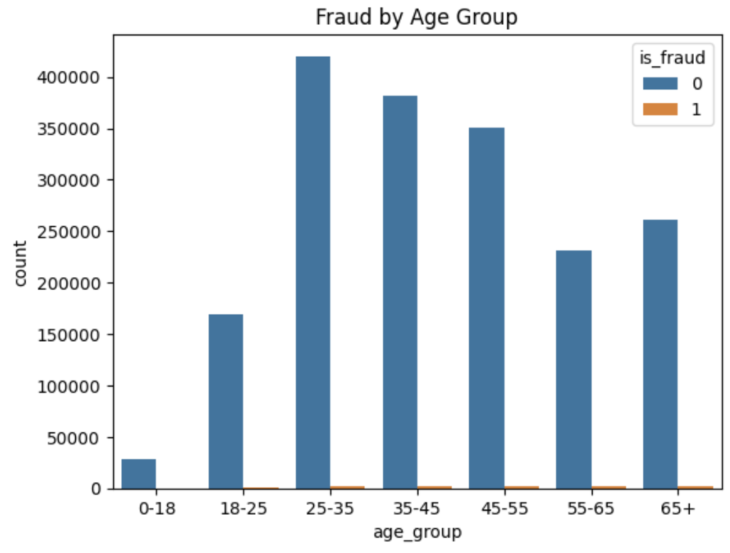
Exploring Credit Card Transaction Data

Slide 10
Literature Review
Using SMOTE to combat class imbalance, Haddab (2022) employed logistic regression, random forest, Naive Bayes, and multilayer perceptron algorithms to select the best performing classifier
Random forest had the best performance with an accuracy of 98.96%, precision of 97.38%, and recall of 83.63%
Also with the goal to find the best performing classifier, Afriyie et al. (2023) used logistic regression, decision tree, and random forest along with undersampling the data
Random forest performed best with an AUC of 98.8%

Slide 11
Literature Review
Alabrah (2023) compares five classifiers with and without the normalization of outliers to detect differences in performance
Machine learning models in the second experiment with outliers normalized provided more robust results
Mustaqim et al. (2021) studied the effectiveness of feature selection and its influence on classification results by employing recursive feature elimination with cross validation (RFECV)
Found that applying different values of k lead to lower accuracy in decision tree model but no effect in Naive Bayes model
Increase in k resulted in lower number of selected features

Slide 12
02
Objectives and Research Questions

Slide 13

Objectives
Compare three resampling techniques with three machine learning algorithms to identify the best performing model
Examine differences in performance of models with and without outliers
Observe performances of models with all and selected features
Source: Gareth (2022)
Notes:
Image Source
Gareth. (2022, June 30). How common is credit card fraud? (And what to do about it) - Consumer Boomer. Consumer Boomer. https://consumerboomer.com/how-common-is-credit-card-fraud-and-what-to-do-about-it/

Slide 14
Research Questions
Knowing that there exists a bias towards non-fraudulent transactions, what sampling technique will perform better for creating an accurate fraud detection model?
In relation to the first question, will the models perform better when outliers are present and transformed, or when no outliers exist?
What are the essential features that assist in determining the two classes of transactions, legitimate and fraudulent?

Slide 15
03
Methodology

Slide 16
Data Description
“A simulated credit card transaction dataset containing legitimate and fraud transactions from the duration of January 1st to December 31st, 2020” (Shenoy, 2019)
Generated using Sparkov Data Generation tool designed by Brandon Harris
Contains credit cards of 1000 consumers in the United States and 800 merchants
1,296,675 observations with 23 features

Slide 17
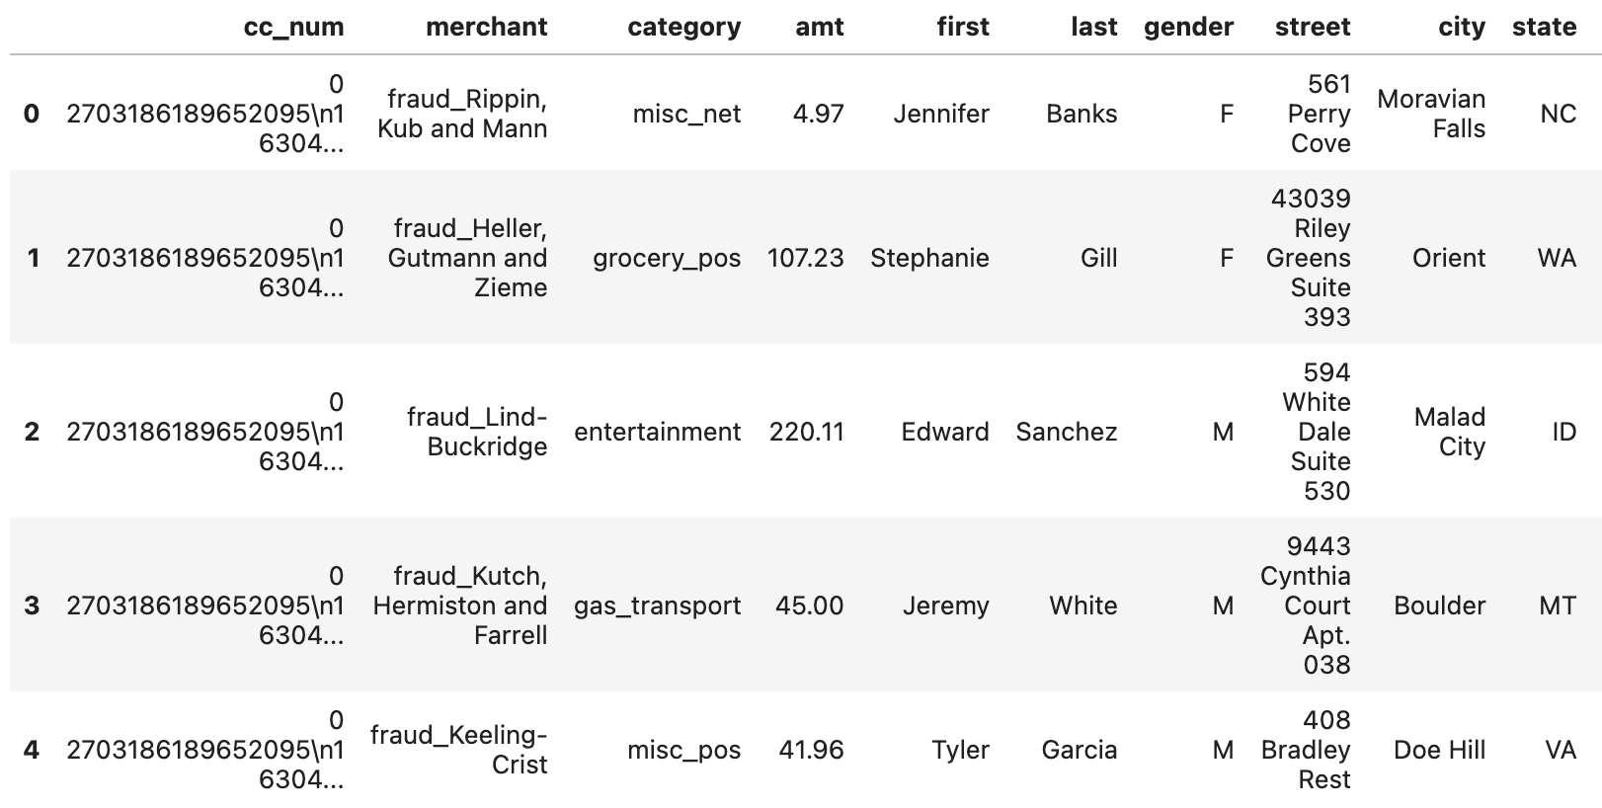
Dataset

Slide 18
Methodology
Data Preparation
Reading in the datasets into pandas DataFrame, data type conversions, feature engineering, dropping redundant variables
Exploratory Data Analysis (EDA)
Univariate and bivariate analysis, data visualization (bar plots, box plots, pie charts)
Revisit data preparation stage
Data Preprocessing
Create copy of dataset
Scaling the datasets (RobustScaler on original dataset and MinMaxScaler on copied dataset)
One-hot encoding of categorical features, train-test split (70% training, 30% testing), feature selection using RFECV

Slide 19
Methodology
Data Modelling
Pipelines to chain resampling technique with machine learning algorithm
Resampling techniques: random under sampling, random over sampling, synthetic minority over sampling (SMOTE)
Machine learning algorithms: logistic regression, decision tree, random forest
Hyperparameter tuning with RandomizedSearchcv
Fitted with the training set
Performance
Performance metrics: accuracy, recall, precision, Matthew’s correlation (MCC), F1 score
Receiver operating characteristic curves (ROC) and area under the curve value (AUC)

Slide 20
Tools
Pandas
Open source package for data analysis and manipulation (Pandas, 2023)
Scikit-learn (Sklearn)
Open source package for machine learning (Pedregosa et al., 2011)
imblearn
Open source MIT-licensed library for managing imbalanced data (The imbalance-learn developers, 2023)
NumPy
Scientific computing package to perform operations on arrays (NumPy Developers, 2022)
Matplotlib
Data visualization package for creating plots (The Matplotlib development team, 2023)
Seaborn
High level interface data visualization package for graphing (Waskom, 2022)

Slide 21
04
Results

Slide 22
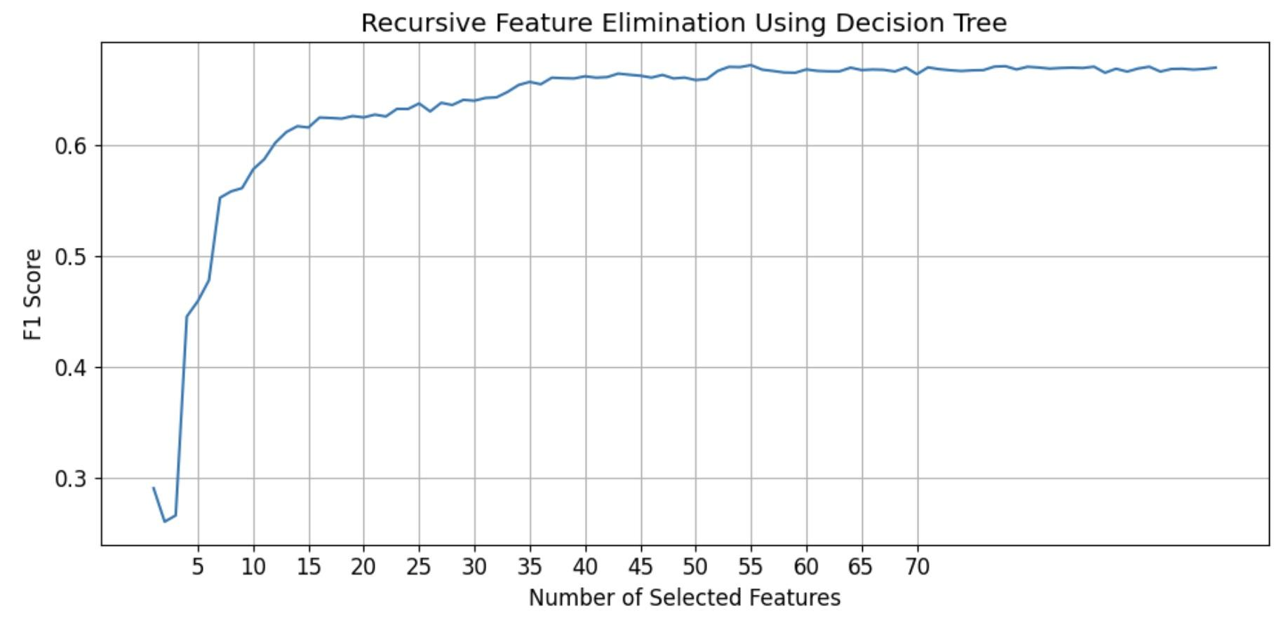
Feature Selection
Best performing number of features was 55
Features selected included:
amt (amount)
gender
lat (latitude)
long (longitude)
year
age

Slide 23
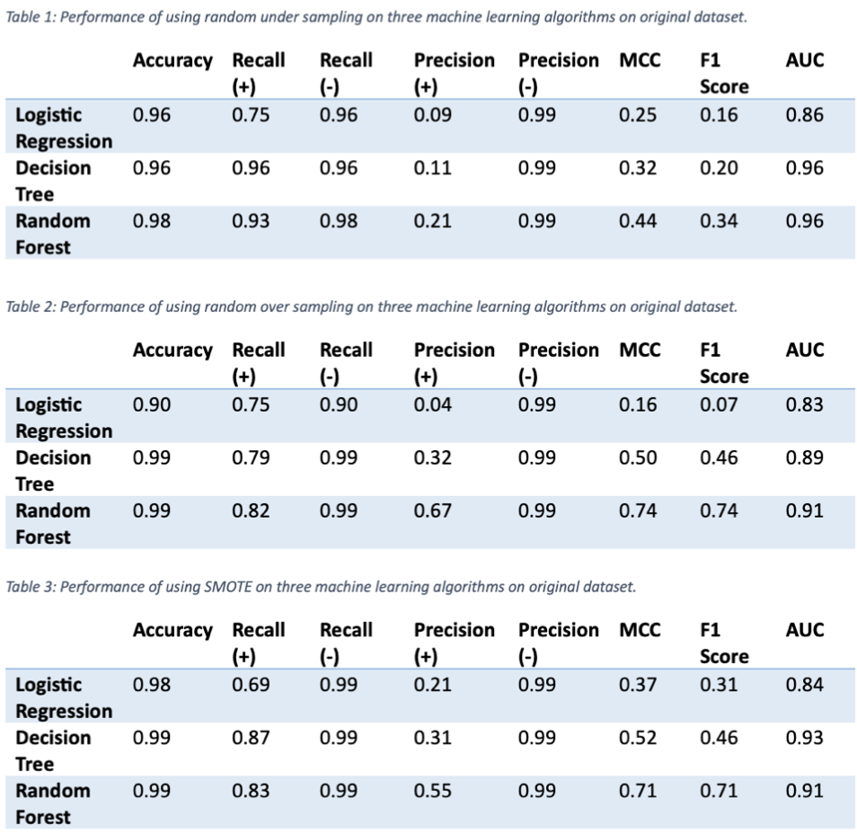
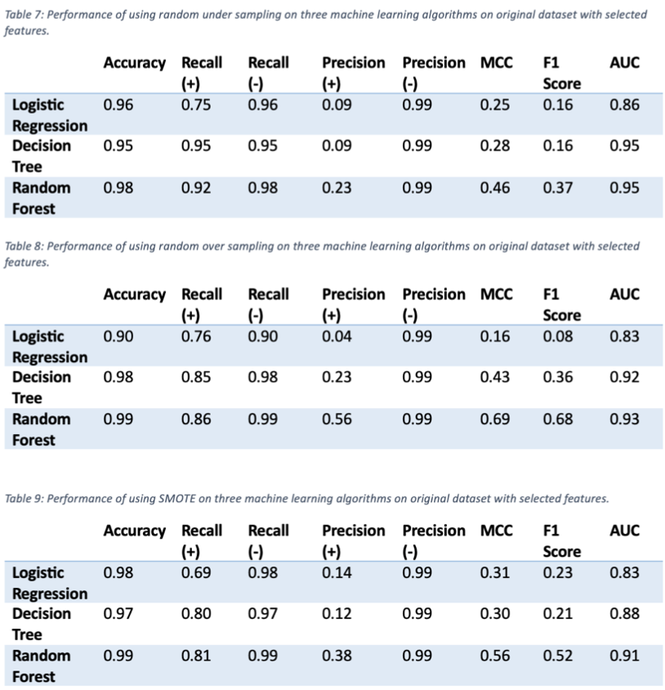
Performance of models on original dataset using RobustScalar containing all features vs selected features
Notes:
The three tables on the left contains all features whereas the remaining three tables to the right contain only the selected features.

Slide 24
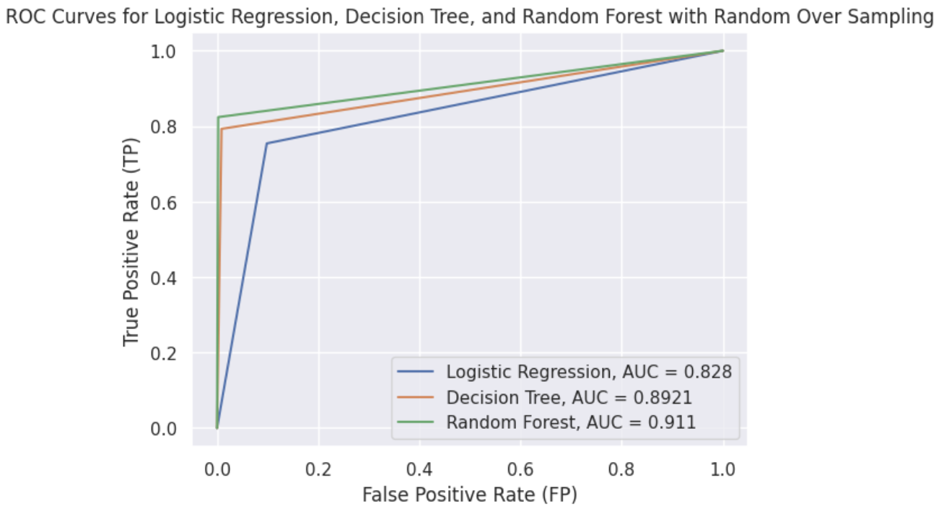
ROC Curves for Random Over Sampling

Slide 25
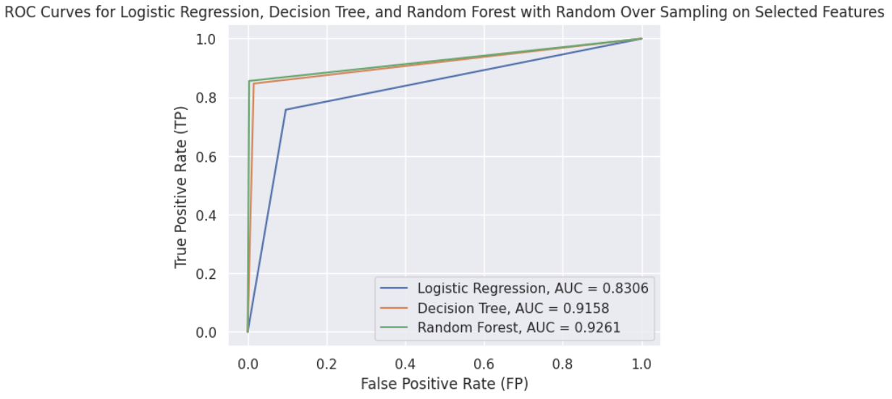
ROC Curves for Random Over Sampling (Selected Features)

Slide 26
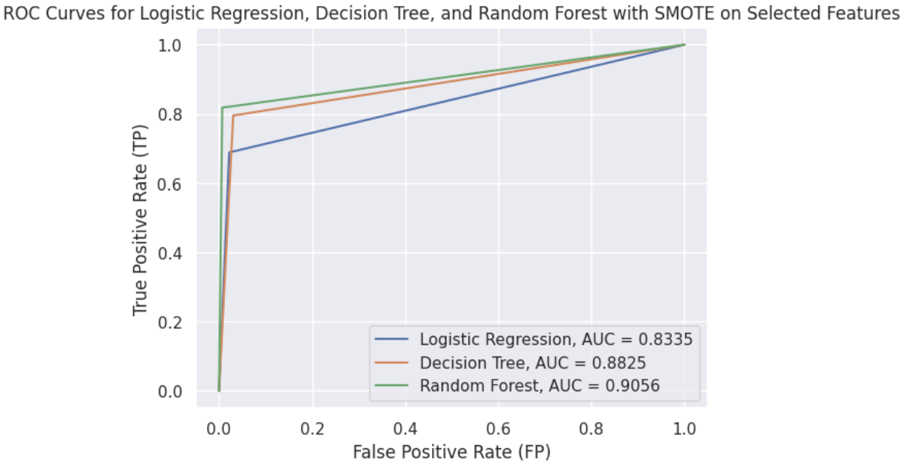
ROC Curves for SMOTE (Selected Features)

Slide 27
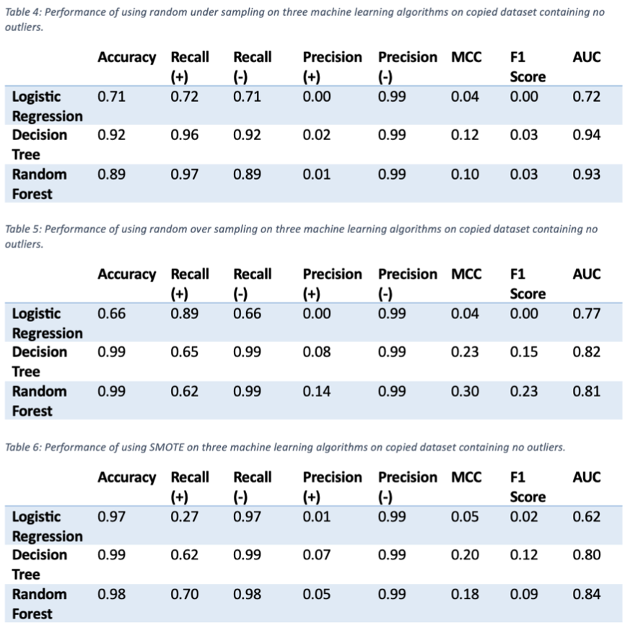
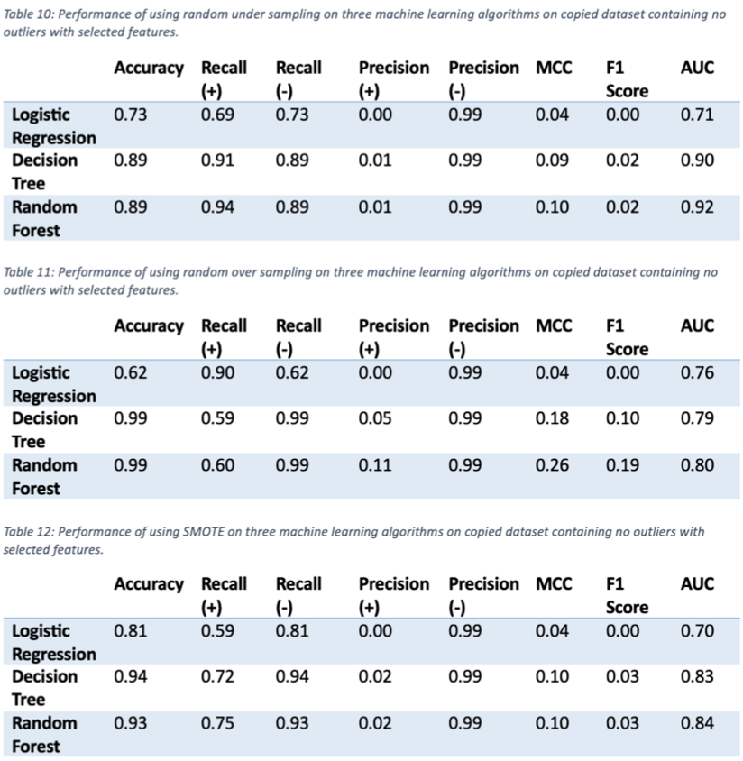
Performance of models with no outliers containing all features vs selected features
Notes:
The three tables on the left contains all features whereas the remaining three tables to the right contain only the selected features.

Slide 28
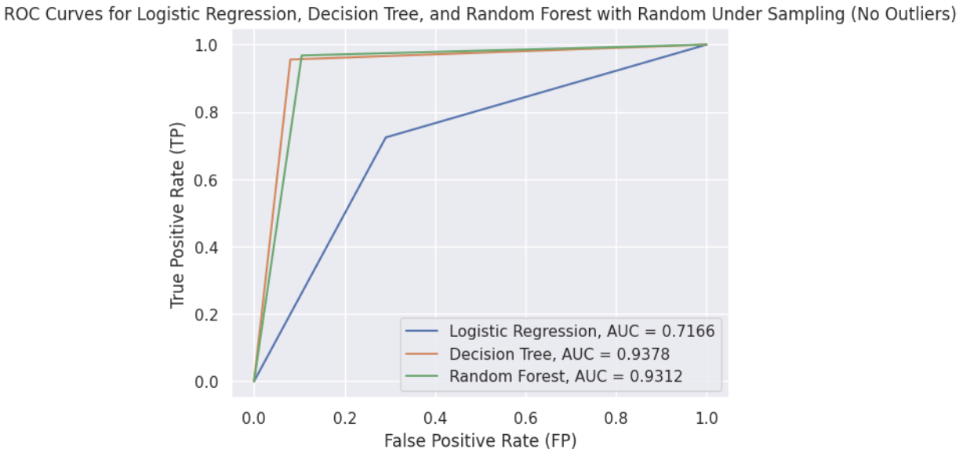
ROC Curves for Random Under sampling

Slide 29
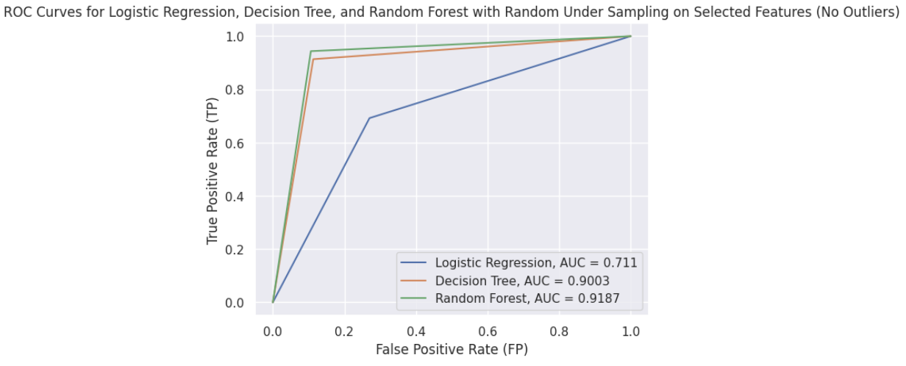
ROC Curves for Random Under sampling (Selected Features)

Slide 30
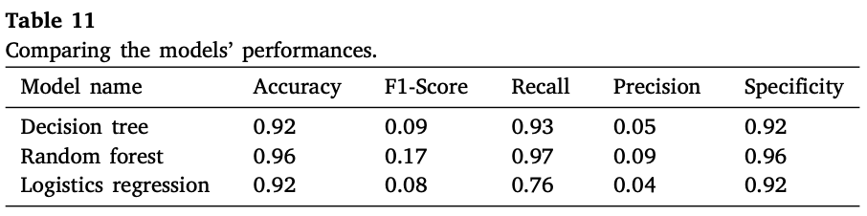
Comparing Results with Previous Studies
In this study, models created with original dataset that underwent under sampling and containing all features (Table 1) achieved somewhat better performance than Afriyie et al. (2023)
Logistic regression and decision tree model had an accuracy of approximately 96% in comparison to 92% in their study
F1 score of models in both studies were however relatively weak
Recall of the positive class were relatively similar
Precision for the positive class in both sets of models were low
Source: Afriye et al. (2023)

Slide 31
Comparing Results with Previous Studies
Similar to what was observed in Alabrah’s (2023) study, models created with the original dataset using RobustScalar had higher performance in comparison to models containing no outliers in terms of precision, MCC, and F1 score
Almost in line with the findings of Afriyie et al. (2023) and Haddab (2022), random forest with random over sampling was the best performing classifier
With criterion set to entropy and a maximum depth of 25

Slide 32
Limitations and Recommendations
Selection of hyperparameter tuning algorithm
Only values selected by the user enter the grid space, leaving out other potential values that offer a more optimal set
Adopt Bayesian optimization as a potential alternative (Gupta, 2020)
Utilizing ROC AUC as a performance metric
Provided overly optimistic results, biased towards the negative class, which is legitimate transactions
Employ instead precision-recall curves since more emphasis is given to the minority class (Brownlee, 2020)
Examined limited machine learning algorithms
Other supervised machine learning algorithms may be better classifiers for distinguishing the two types of transactions
Consider Support Vector Machine (SVM), Naive Bayes, and among others

Slide 33
Conclusion
Creating a fraud detection model is a continuous process
Explored three resampling techniques with three machine learning algorithms, examined performance of models with and without outliers and with selected features
Three resampling techniques employed were random under sampling, random over sampling, and SMOTE
Three machine learning algorithms were logistic regression, decision tree, and random forest
Applied Sklearn RobustScalar on original dataset and MinMaxScalar for copied dataset
RFECV for feature selection

Slide 34
Conclusion
Models that were created using the original dataset with RobustScalar and with all features overall achieved better performance across all metrics in comparison to the copied dataset with no outliers
Specifically, over sampling the data and using random forest on the original dataset achieved the highest performance

Slide 35
References
Afriyie, J. K., Tawiah, K., Pels, W. A., Addai-Henne, S., Dwamena, H. A., Owiredu, E. O., ... & Eshun, J. (2023). A supervised machine learning algorithm for detecting and predicting fraud in credit card transactions. Decision Analytics Journal, 6, 100163.
Alabrah, A. (2023). An Improved CCF Detector to Handle the Problem of Class Imbalance with Outlier Normalization Using IQR Method. Sensors, 23(9), 4406.
Brownlee, J. (2020, January 5). ROC Curves and Precision-Recall Curves for Imbalanced Classification - MachineLearningMastery.com. MachineLearningMastery.com. https://machinelearningmastery.com/roc-curves-and-precision-recall-curves-for-imbalanced-classification/
Chartered Professional Accountants of Canada. (2023, February 15). Unlikely targets: More young Canadians report being a victim of financial fraud than older Canadians: CPA Canada survey reveals. Cpacanada.ca. https://www.cpacanada.ca/en/the-cpa-profession/about-cpa-canada/media-centre/2023/february/cpa-canada-fraud-survey-2023
Dickey, C. (2023, March 13). Ways your credit card info might be stolen and how to prevent it. Bankrate; Bankrate.com.
https://www.bankrate.com/finance/credit-cards/5-ways-theives-steal-credit-card-data/

Slide 36
References
Falco, A. (2023). Understanding the Threat of Card Transaction Fraud and its Impact on the Financial Ecosystem | Waylay Blog. Waylay.io. https://www.waylay.io/articles/understanding-the-threat-of-card-transaction-fraud-and-its-impact-on-the-financial-ecosystem#:~:text=Globally%2C%20card%20fraud%20is%20making,less%20than%2024%20hours%20old.
Gupta, L. (2020, November 21). Comparison of Hyperparameter Tuning algorithms: Grid search, Random search, Bayesian optimization. Medium; Analytics Vidhya. https://medium.com/analytics-vidhya/comparison-of-hyperparameter-tuning-algorithms-grid-search-random-search-bayesian-optimization-5326aaef1bd1
Haddab, D. M. (2022). Data Science & Machine Learning Methods for Detecting Credit Card Fraud. International Journal of Data Science and Advanced Analytics (ISSN 2563-4429), 4(4), 71-75.
Kosourova, E. (2022, March 21). Data Science in Banking: Fraud Detection. Datacamp.com; DataCamp. https://www.datacamp.com/blog/data-science-in-banking
Mustaqim, A. Z., Adi, S., Pristyanto, Y., & Astuti, Y. (2021, June). The effect of recursive feature elimination with cross-validation (RFECV) feature selection algorithm toward classifier performance on credit card fraud detection. In 2021 International conference on artificial intelligence and computer science technology (ICAICST) (pp. 270-275). IEEE.

Slide 37
References
NumPy Developers. (2022). What is NumPy? — NumPy v1.25 Manual. Numpy.org. https://numpy.org/doc/stable/user/whatisnumpy.html
Pandas. (2023). pandas - Python Data Analysis Library. Pydata.org. https://pandas.pydata.org/
Pedregosa, F., Varoquaux, G., Gramfort, A., Michel, V., Thirion, B., Grisel, O., ... & Duchesnay, É. (2011). Scikit-learn: Machine learning in Python. the Journal of machine Learning research, 12, 2825-2830.
‌Qualetics Team. (2019, October 28). Data Science In Banking: 5 Use Cases For Banks. Qualetics Data Machines| Data Analytics, AI | Enable Analytics & AI for Web and Mobile Applications. https://qualetics.com/data-science-in-banking-5-use-cases-for-banks/
Rafter, D. (2017, September 14). What Is Credit Card Fraud? LifeLock by Norton. https://lifelock.norton.com/learn/fraud/what-is-credit-card-fraud
Shenoy, K. (2019). Credit Card Transactions Fraud Detection Dataset. Kaggle.com. https://www.kaggle.com/datasets/kartik2112/fraud-detection
The imbalanced-learn developers. (2023). imbalanced-learn documentation — Version 0.11.0. Imbalanced-Learn.org. https://imbalanced-learn.org/stable/

Slide 38
References
The Matplotlib development team . (2023). Matplotlib — Visualization with Python. Matplotlib.org. https://matplotlib.org/
Waskom, M. (2022). seaborn: statistical data visualization — seaborn 0.12.2 documentation. Pydata.org. https://seaborn.pydata.org/

